Slide 1
Jira Balloting
Navigating the process
Lloyd McKenzie
December 1, 2020

Slide 2

Who am I?
Name: Lloyd McKenzie
Company: Gevity
Background:
One of FHIR’s 3 initial editors
Co-chair FHIR Management Group and FHIR-Infrastructure
HL7 Fellow
Principle developer of HL7’s Jira feedback & balloting solution
lmckenzie@gevityinc.com

Slide 3

This presentation
Can be downloaded here:
https://github.com/FHIR/documents/tree/master/presentations/2020-12%20Webinars
Is licensed for use under the Creative Commons, specifically:
Creative Commons Attribution 3.0 Unported License
(Do with it as you wish, so long as you give credit)

Slide 4
Objectives
Understand what is changing with Jira balloting
And what’s not
Be able to submit specification feedback
Be able to vote and manage votes using Jira
Questions at any time!

Slide 5
Outline
Background
Jira Basics
Balloting structures
Balloting process
Voting
Advanced balloting

Slide 6
Background

Slide 7
Previous feedback mechanisms
Balloting
STU feedback
Change requests
Raise something at a WGM / on a call

Slide 8
Why change?
Feedback exists in multiple locations - No overall view
No easy way to comment on existing feedback
No easy way to monitor/track feedback items
No way for management groups to monitor progress
‘Authoritative’ source hard to manage
Can’t filter to see feedback by artifact/section/etc.
Poor ‘quality’ of data in spreadsheets
Easy to ‘lose’ feedback once reconciliation done

Slide 9
Evolution of the feedback process
FHIR gForge feedback
FHIR Jira feedback
Jira feedback & balloting for all
Retire ballot desktop

Slide 10
Evolution cont’d
gForge
All feedback in one place
Import feedback from ballot spreadsheets
Discrete data allows search
Audit to trace who changed what when
But
Dropdowns hard to maintain
Dropdowns work for core, but not IGs
Ballot imports clunky (rely on screen-scraping)
Ballot imports painful (lots of manual clean-up)

Slide 11
Evolution cont’d
Jira
Comes with API support
Improved/more reliable spreadsheet import
Drop-downs for all IG
But
Ballot imports still hard to maintain
Only supported FHIR
Jira submission + spreadsheet confusing

Slide 12
Evolution cont’d
Jira feedback & balloting for all
Jira project for all* product families
No requirement to submit spreadsheets
Manage votes directly in Jira
(This is our focus today)
But
Still need to use ballot desktop for sign-up
ANSI management still happens through ballot desktop

Slide 13
Evolution cont’d
Retire ballot desktop
Ballot setup (Notice of Intent to Ballot) in Jira
Ballot sign-up in Jira
Final ballot results in Jira
NOTE: timing and funding of this to be confirmed

Slide 14
Support
U.S. ONC provided funding for:
initial migration from gForge to Jira
The forthcoming rollout of Jira balloting for FHIR and other product families
Thank You!

Slide 15
Jira Basics

Slide 16
What is Jira
Issue management tool made by Atlassian
Same company who makes Confluence
HL7 has a free license because we’re a non-profit
Tool allows lots of customization & automation

Slide 17
Jira and HL7
HL7 is migrating all ‘tracking’ activities from gForge to Jira
Some simple tooling feedback will remain in Git
Jira is used for PSSs, Terminology and other feedback mechanisms
http://jira.hl7.org

Slide 18
Accounts
Read-only access is anonymous users
HL7 Jira account required to
Create issues
Comment on issues
Manage issues
HL7 Jira accounts are free
HL7 Jira accounts are not the same as your HL7 account
But are the same as your Confluence account
Notes:
Search capability is limited for anonymous

Slide 19
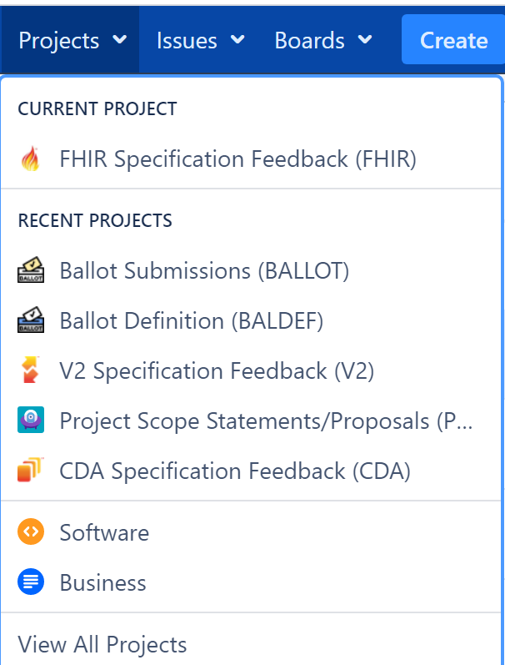
Projects
Group issues related to a particular topic
There are 6 related to balloting:
BALDEF – defines ballots
BALLOT – submissions & votes
FHIR, CDA, V2, OTHER – capture comments
Others
NEWID, PSS, UP, etc.

Slide 20
Issues
Records created within a project
Have an ‘id’ that starts with the project key
E.g. FHIR-12345, BALLOT-7890
Have a ‘summary’
Have a status
Can be linked
Can be commented on (sometimes)

Slide 21
Issues

Slide 22
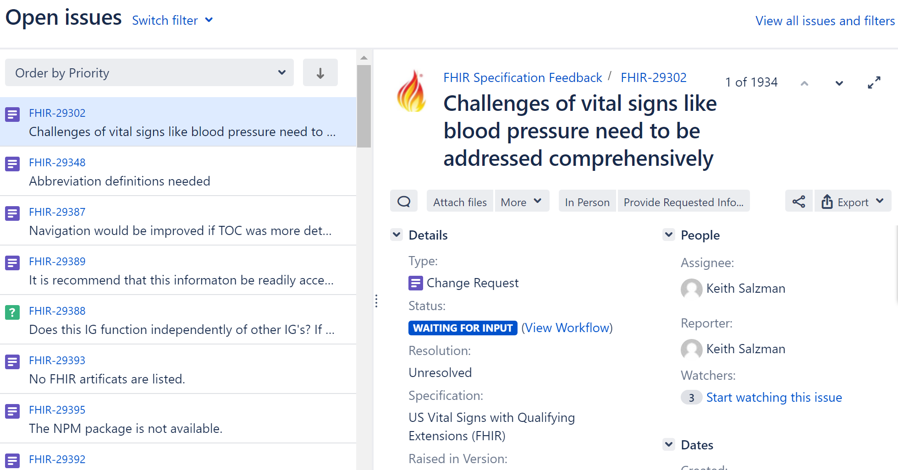

Slide 23
Balloting Structures

Slide 24
Jira ballot organization
HL7 Ballots
HL7 Ballot Submissions
Specification Feedback
Ballot Definition
Ballot Submission
Change Proposal
Votes on
Vote
Same as
Technical Correction
sub-task-of
Ballot Vote
Votes On
Question
Comment

Slide 25
Ballot Definition
HL7 Ballots
HL7 Ballot Submissions
Specification Feedback
One per ballot
Summarizes ballot results
Ballot Definition
Ballot Submission
Change Proposal
Votes on
Vote
Same as
Technical Correction
sub-task-of
Ballot Vote
Votes On
Question
E.g.
2019-May US-Core STU 2 ballot
Comment

Slide 26
Ballot Submission
HL7 Ballots
HL7 Ballot Submissions
Specification Feedback
Ballot Definition
Ballot Submission
Change Proposal
One per user per ballot
Reflects overall vote
Votes on
Vote
Same as
Technical Correction
sub-task-of
Ballot Vote
Votes On
Question
E.g.
2019-May US-Core R3.1 STU
Comment

Slide 27
Change Proposal
HL7 Ballots
HL7 Ballot Submissions
Specification Feedback
Ballot Definition
Ballot Submission
Change Proposal
Most common
Any ‘substantive’ change
Only comment that can be voted ‘negative’
Votes on
Vote
Same as
Technical Correction
sub-task-of
Ballot Vote
Votes On
Question
E.g.
“Please make deceasedDate mustSupport”
Comment

Slide 28
Technical Correction
HL7 Ballots
HL7 Ballot Submissions
Specification Feedback
Ballot Definition
Ballot Submission
Change Proposal
Spelling, grammar, formatting
Can’t vote negative
Votes on
Vote
Same as
Technical Correction
sub-task-of
Ballot Vote
Votes On
Question
E.g.
“HER” should be “EHR”
Comment

Slide 29
Question
HL7 Ballots
HL7 Ballot Submissions
Specification Feedback
Ballot Definition
Ballot Submission
Change Proposal
Not seeking change, just an answer
Consider Zulip instead
Can’t vote negative
Votes on
Vote
Same as
Technical Correction
sub-task-of
Ballot Vote
Votes On
Question
E.g.
“Why are you using polling rather than subscription?”
Comment

Slide 30
Comment
HL7 Ballots
HL7 Ballot Submissions
Specification Feedback
Ballot Definition
Ballot Submission
Change Proposal
No response needed
Consider Zulip instead
Can’t vote negative
Votes on
Vote
Same as
Technical Correction
sub-task-of
Ballot Vote
Votes On
Question
E.g.
“Great Job!”
Comment

Slide 31
Ballot Vote
HL7 Ballots
HL7 Ballot Submissions
Specification Feedback
Ballot Definition
Ballot Submission
Change Proposal
Ties feedback submission
Assigns a ‘weight’ of ‘Affirmative’ or ‘Negative’ to the comment
Ballot Votes influence the overall Submission vote
Votes on
Vote
Same as
Technical Correction
sub-task-of
Ballot Vote
Votes On
Question
Comment

Slide 32
Process Overview
Register
Submit feedback
Vote
Withdraw negatives

Slide 33
Balloting Process

Slide 34
Registering to vote
Register on ballot desktop (like always)
Typically need to be a member or pay a fee
Must register in the registration window
30 days before ballot opening
When registration closes, a Ballot Submission instance will be created in Jira

Slide 35
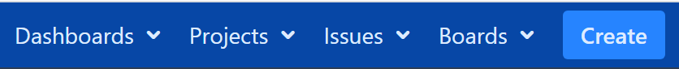
Submit feedback
4 Feedback projects
FHIR, CDA, V2, Other
Must choose proper project for spec giving feedback on
Feedback can be submitted by anyone at any time
Don’t need to wait for the ballot to open
But best to wait until the ballot release is posted
You can vote on feedback submitted by others
You can submit feedback without voting

Slide 36
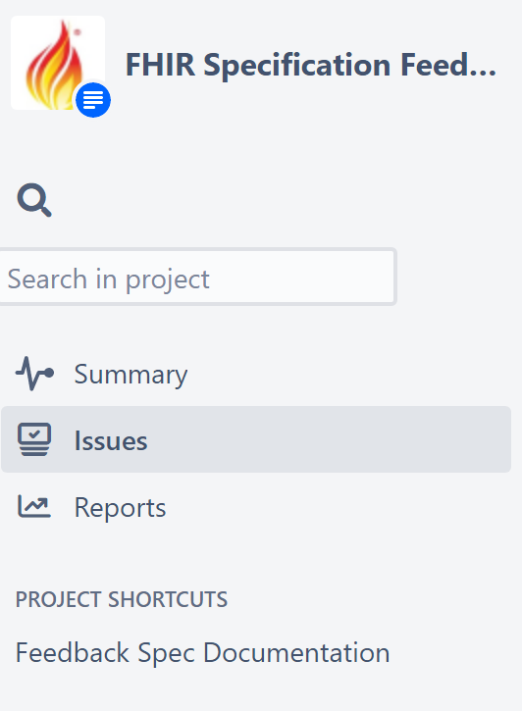
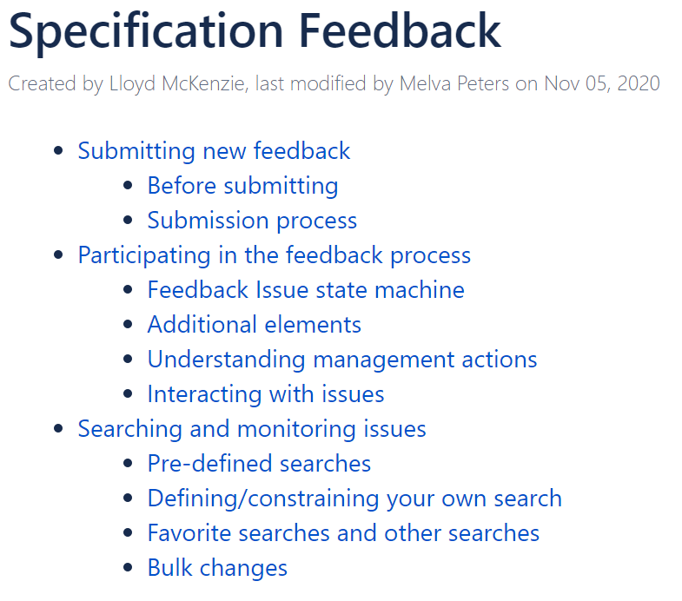

Slide 37
Why vote?
HL7 considers all feedback received. However:
Ballot feedback governs whether specifications are published
Ballot feedback must be resolved prior to publication
Ballot feedback is typically prioritized

Slide 38
Voting
Can only vote if
User is registered for the ballot
Ballot is open (status & dates)
Issue isn’t ‘resolved’
Issue is tied to the spec associated with the issue
Issue is tied to one of the artifacts/pages in the ballot
Can only vote ‘negative’ on ‘change requests’
Technical Corrections, Questions, Comments must be ‘Affirmative’

Slide 39
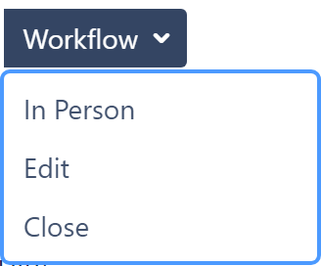
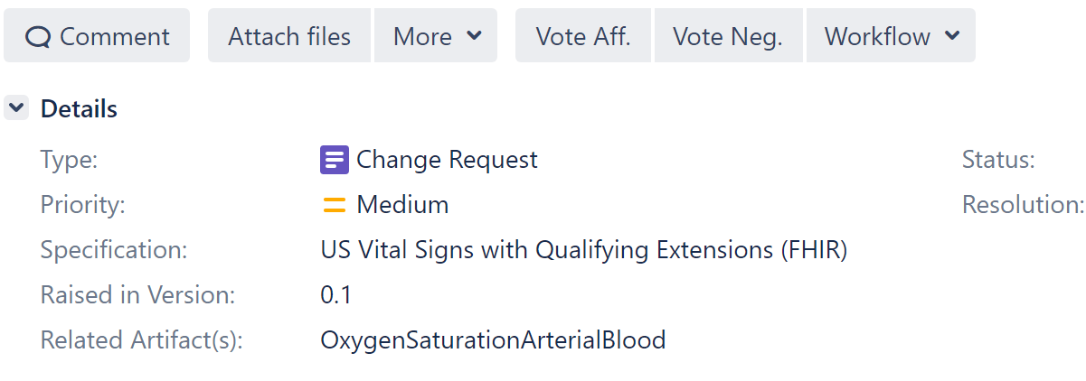
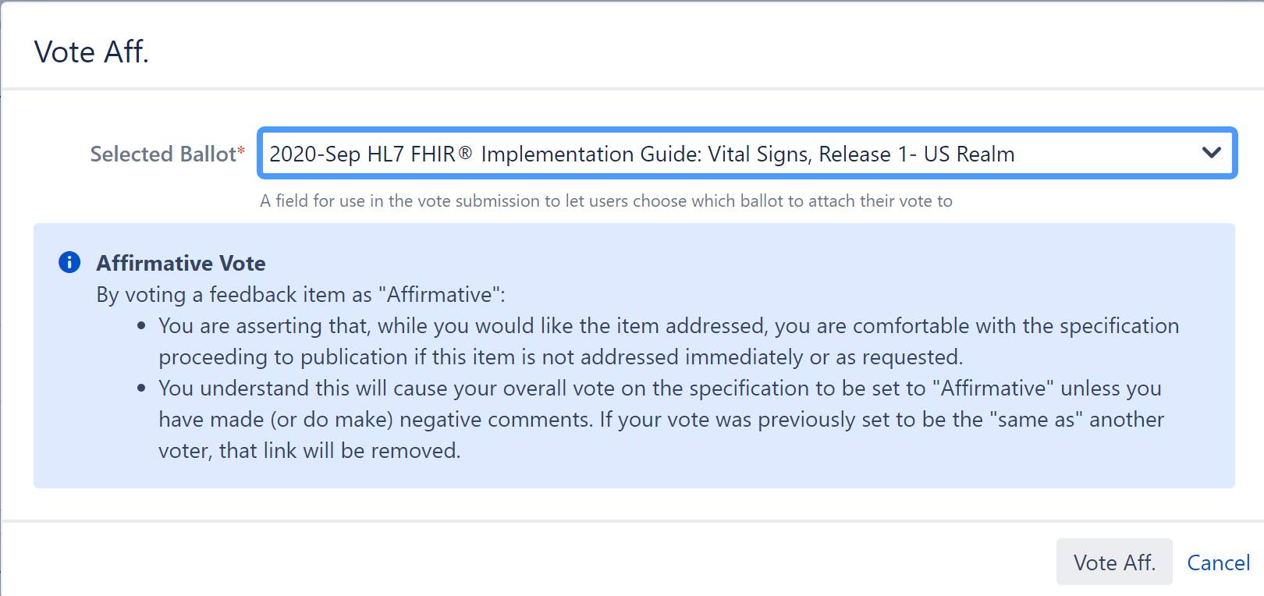
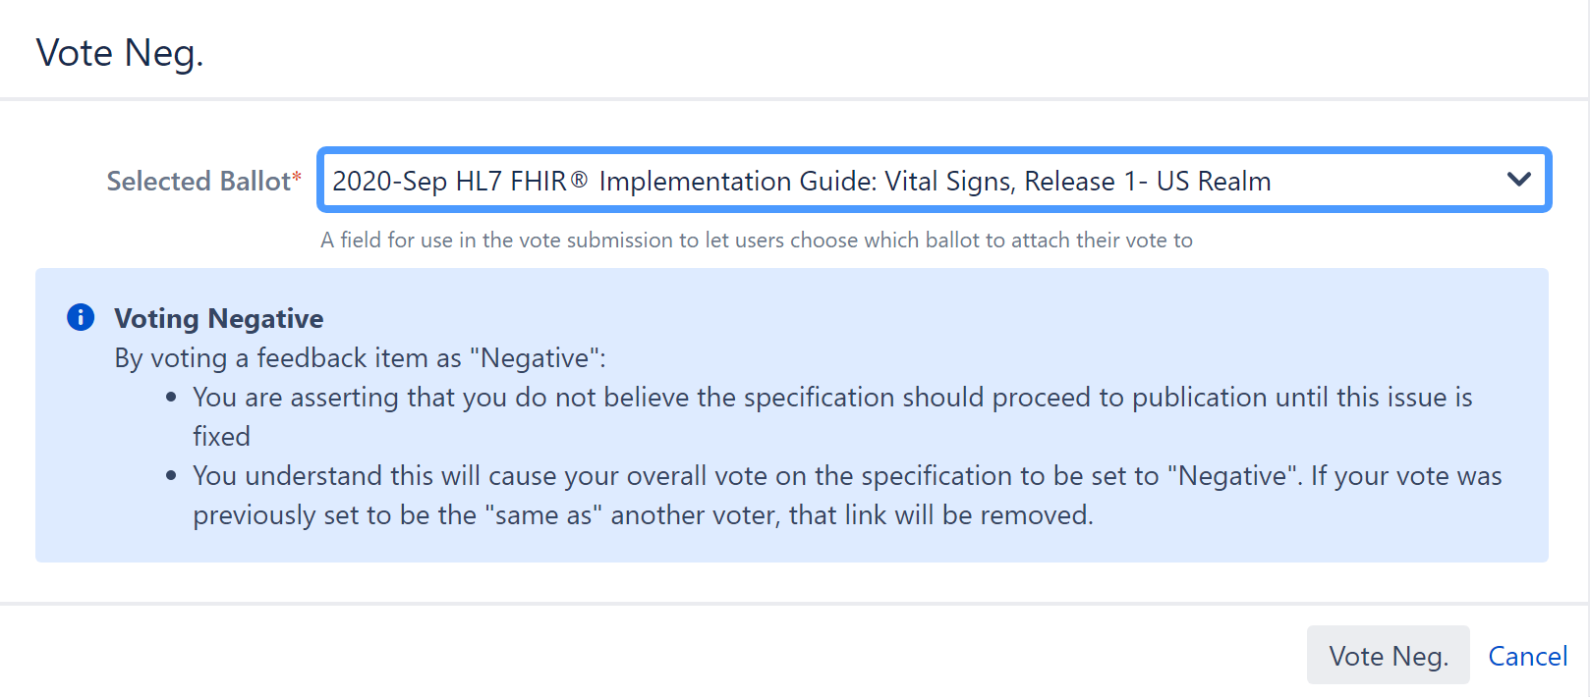
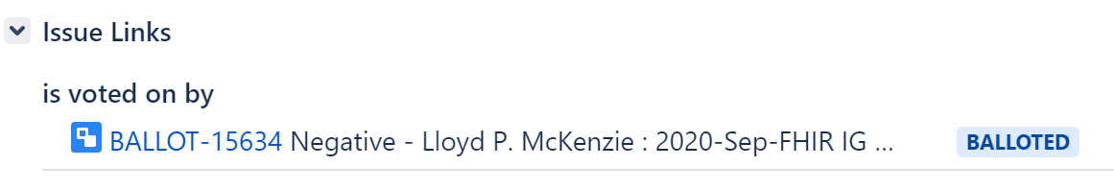

Notes:
List of ballots *might* include more than one – in which case you must choose

Slide 40
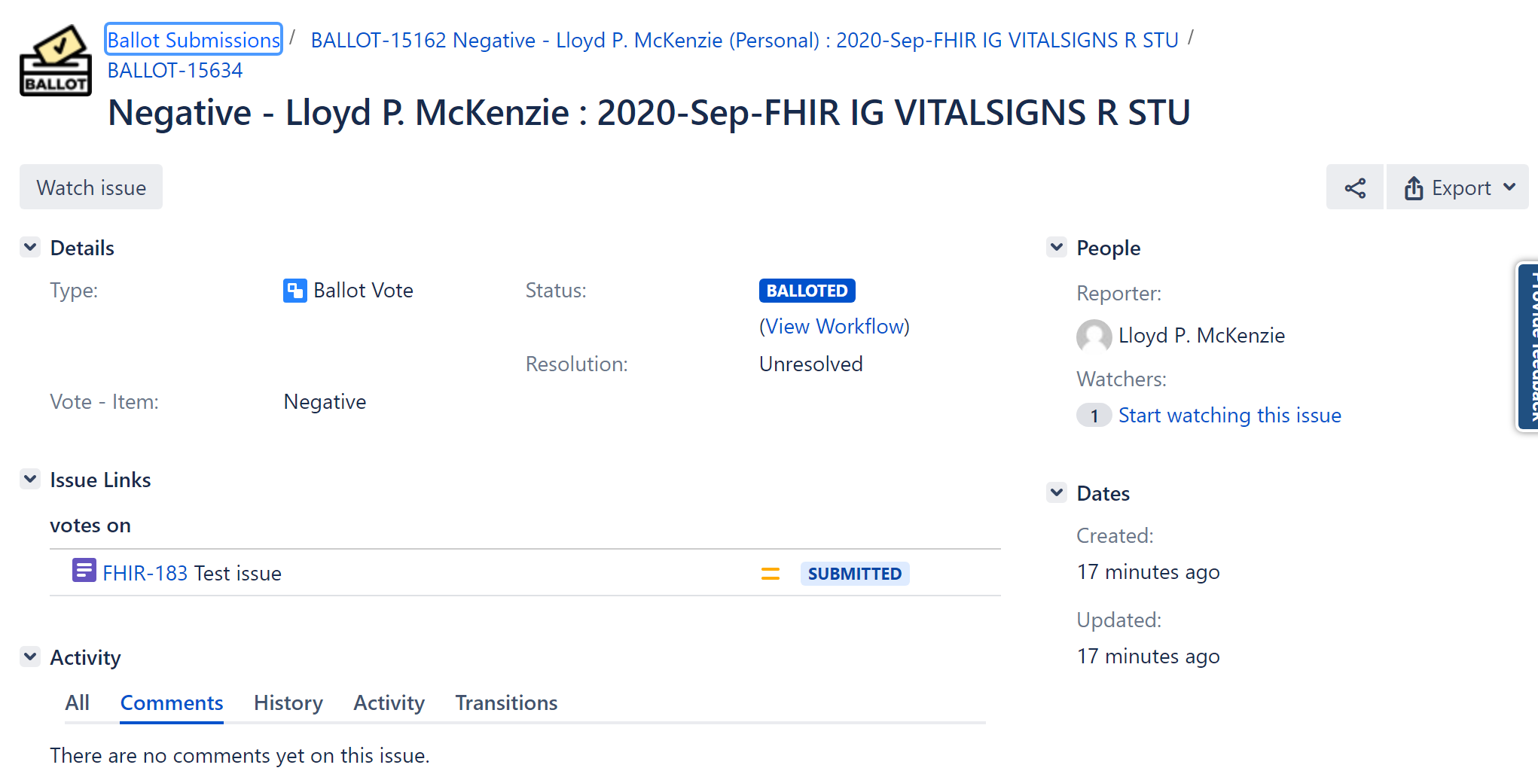
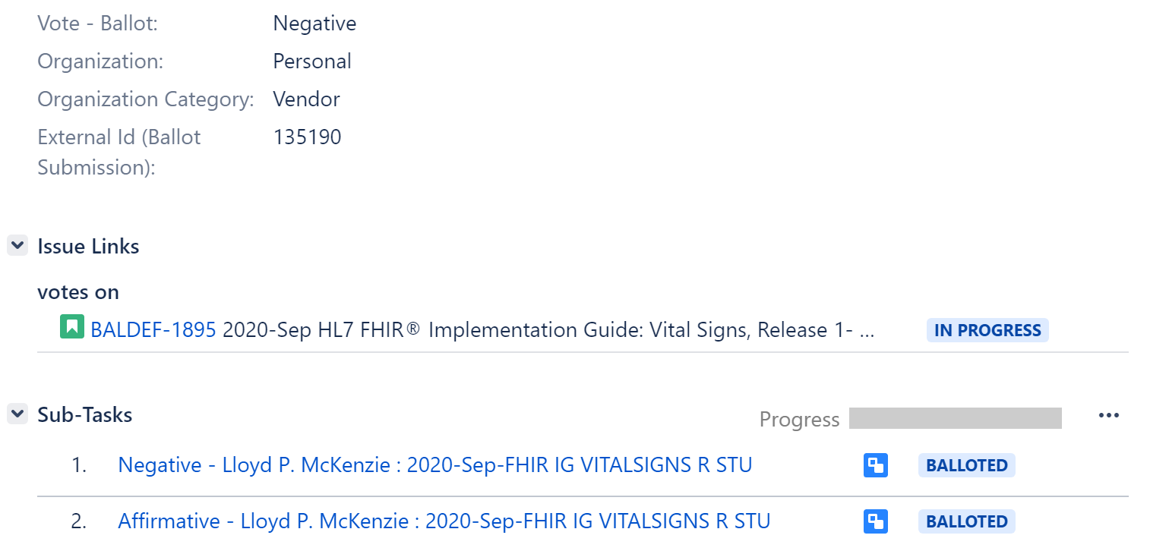

Slide 42
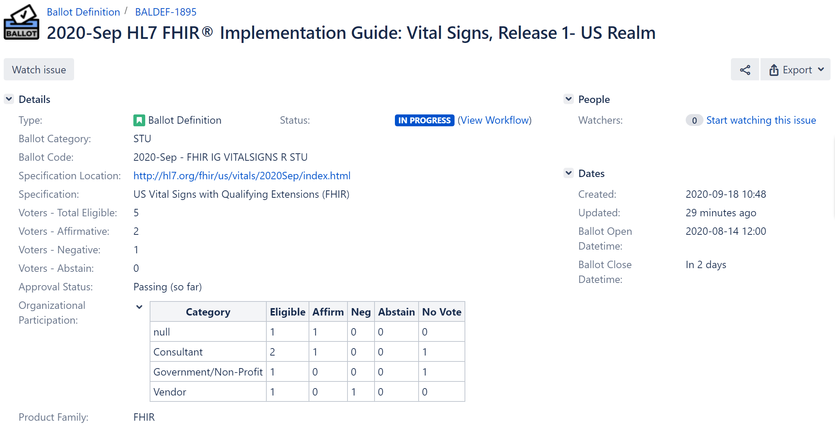
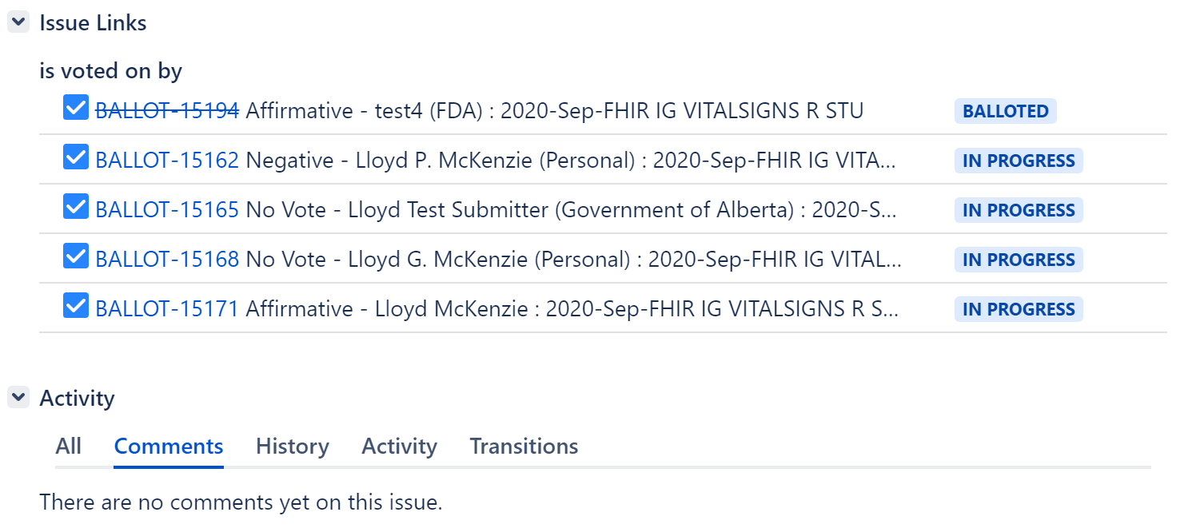

Slide 43
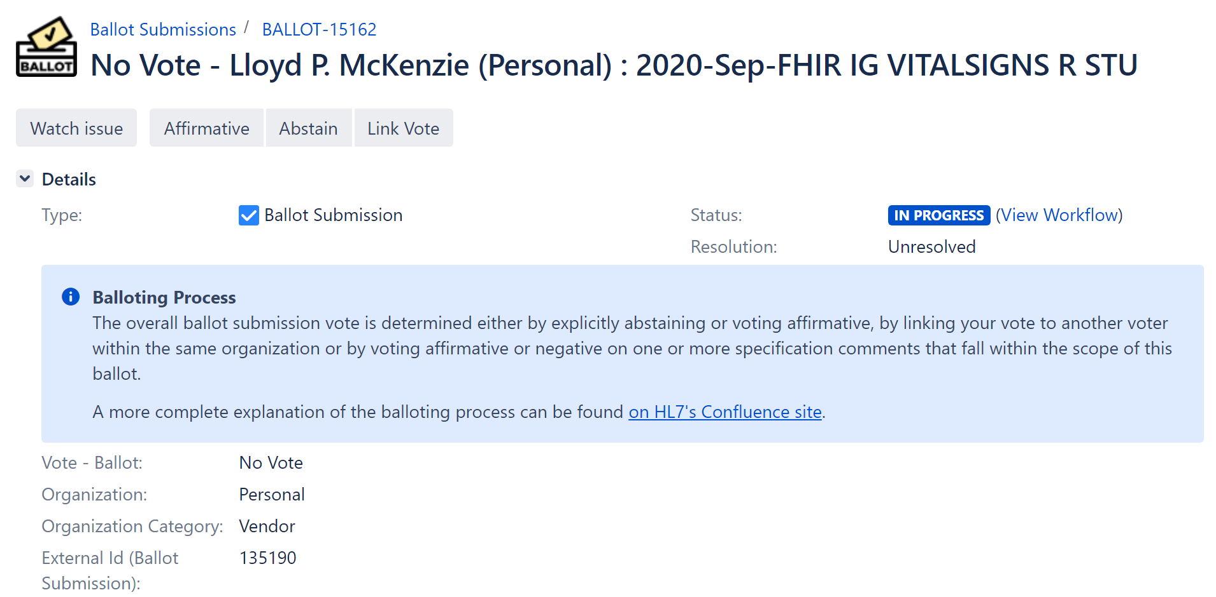
If you don’t have comments

Slide 44
Correlations with ‘old’ process
A-Q – Affirmative vote on Question
A-A – Affirmative vote on Comment
A-T – Affirmative vote on Technical Correction
A-C, A-S – Affirmative vote on Change Proposal
Neg – Negative vote on Change Proposal

Slide 45
Other considerations
Multiple people can vote on the same feedback issue
Votes could differ – some affirmative, some negative
A work group might resolve an issue before the ballot closes
Don’t forget to vote after raising a new issue
Creating the issue doesn’t associate a vote with it

Slide 46
Managing Votes

Slide 47
After a ballot closes
Voting will no longer be possible
Un-voting will no longer be possible
Changing an overall vote will no longer be possible
Retraction and Withdrawal become possible
Retract = Treat an item as if it wasn’t voted on
Only possible if no resolution exists
Withdraw = Change negative vote item to an affirmative
Only possible if a resolution exists

Slide 48
Withdraw/Retract
Can be done on the feedback issue or on the ballot vote.
Will only see the option that is ‘available’ based on whether the issue has been resolved or not.
NOTE:
If multiple people have voted on an issue, each must withdraw/retract independently
Even if the vote was ‘same as’

Slide 49
Withdraw all
This can be done at the ballot submission level
Withdraws all ‘eligible’ ballot votes
If some items don’t have a resolution, can’t withdraw those
Retractions must be done vote by vote

Slide 50
Locking a ballot
At some point, a ballot’s reconciliation is final
Ballot Definition and all submissions change to ‘Locked’
At that point, no further retractions/withdrawals are possible
The ballot’s pass/fail status becomes final

Slide 51
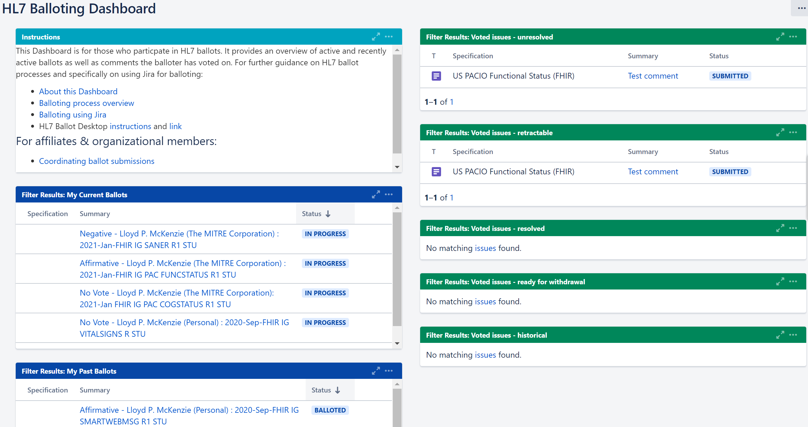
HL7 Balloting Dashboard
https://jira.hl7.org/secure/Dashboard.jspa?selectPageId=11000

Slide 52
Advanced Balloting

Slide 53
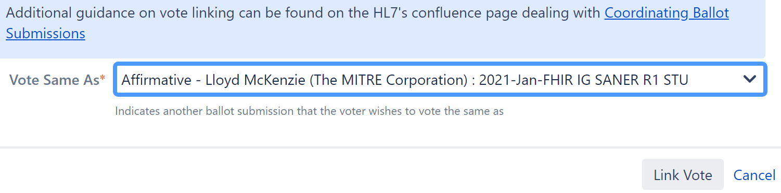
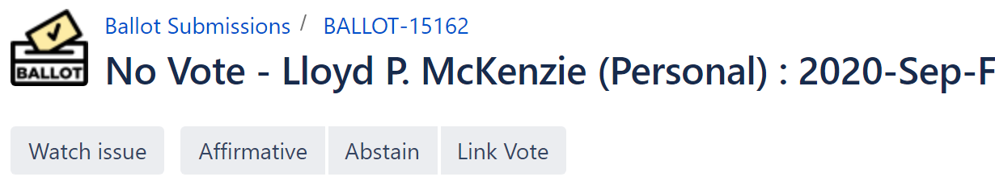
Vote “Same as”
Organizational/Affiliate voters only
Tie your vote to anyone in your org/affiliate who’s voted
Their vote can change…
Your vote will be the same as theirs
You will have to manage your own vote after close

Slide 54
Spreadsheet voting
If you really want to vote with spreadsheets, you can
Caveats
Balloter is responsible for loading the spreadsheet, not HL7 volunteers
Cleaning spreadsheets is time-consuming
All listed individuals MUST have Jira accounts
If you are unable to import before the ballot close deadline
Comments won’t count in the ballot
Comments will need to be entered manually

Slide 55
Spreadsheet voting – process
Download the spreadsheet from the ballot desktop
Fill it out
Encourage your voters to fill it out ‘properly’
Consolidate spreadsheets if necessary
Use the ‘Load Ballot Comments’ option on the Ballot Dashboard
Read the emailed updated spreadsheet and fix any errors
Rinse, repeat

Slide 56
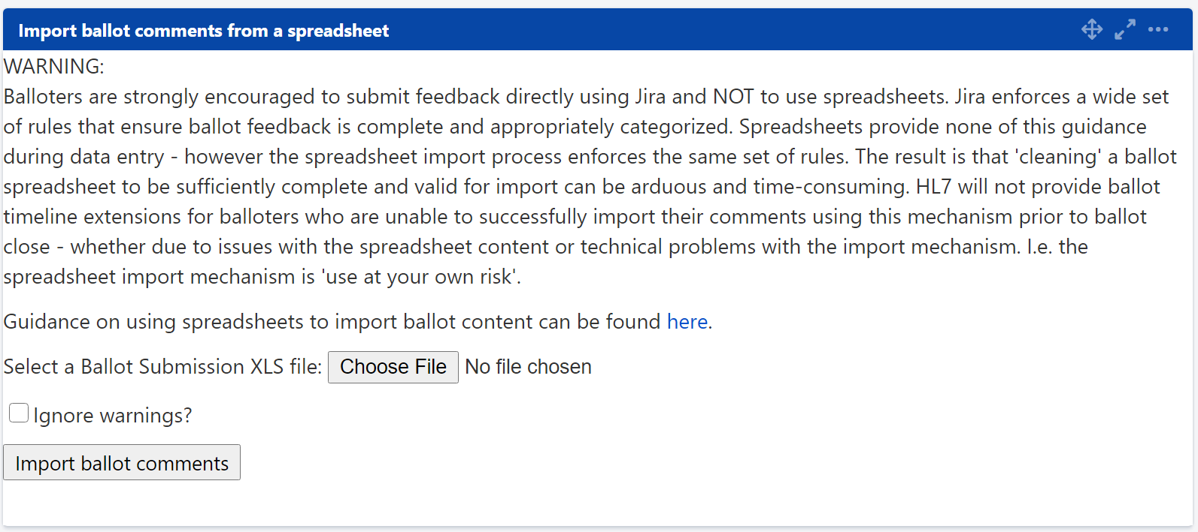
Spreadsheet voting – screen

Slide 57
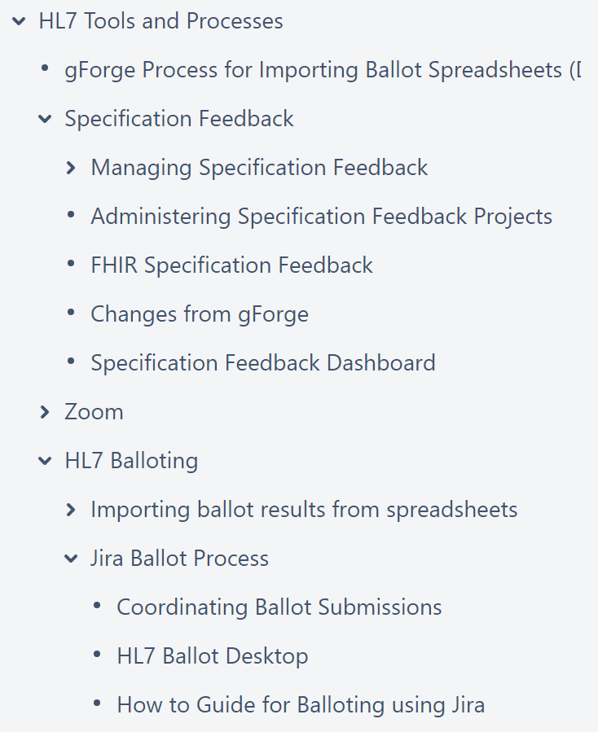
When all else fails
or
http://chat.fhir.org
(Jira/Confluence stream)

Slide 58
Timeframe for roll-out
Testing in progress now
If all goes well…
Trial ballot January cycle
Additional ballots May cycle (additional product families)
All ballots Sept cycle?

Slide 59



Questions / Discussion
lmckenzie@gevityinc.com
Or, better yet, include the community and ask/discuss on chat.fhir.org

